Slide 1

EMBSYS 105 Programming with Embedded & Real-Time Operating Systems
Instructor: Nick Strathy, nstrathy@uw.edu
TA: Gideon Lee, gideonhlee@yahoo.com
© N. Strathy 2020
Lecture 8 3/2/2020

Slide 2
Looking ahead
Date | Lecture number | Assignment
1/6 | L1 | A1 due* before L2
1/13 | L2 | A2 due before L3
1/20 | L3 | A3 due before L4
1/27 | L4 | A4 due before L5
2/3 | L5 | A5 due before L7, Project due before L10
2/10 | L6
2/17 | Holiday – enjoy!
2/24 | L7
3/2 | L8, Guest Lecture: Bill Lamie (CEO) & Yuxin Zhou VP Eng of Express Logic
3/9 | L9
3/16 | L10 – Student presentations
* Assignments are due Sunday night at 11:59 PM

Slide 3
Previous Lecture (L7) Overview
Assignment 5 Touch Driver
Project design suggestions
GenerateMp3Header.ps1 tool
Audacity tool
Reducing Code Memory footprint
Communicating with the vs1053 Chip
Fun: previous generation MP3 Player
SD/MMC
FAT File System
Read a directory with Arduino SD library

Slide 4
Current Lecture (L8) Overview
Project documentation
Increasing clock rate on STM32F401RE
Add a command shell to a multithreading app
Findings of an embedded survey
Guest lecture Bill Lamie, Yuxin Zhou
SD Card protocol

Slide 5
Start thinking about…
Student Presentations in 2 weeks
2-4 minutes
Slides – your features, design, RTOS services used
Demo!

Slide 6
Demo (Take 2)
Revisit previous generation MP3 Player
Notice features
Think of implementation
Browse design diagrams for this MP3 Player

Slide 7
Setting the system clock rate
Explore section 6 of the STM32F401 RM0368 Reference Manual (841 pages)
http://www.st.com/content/ccc/resource/technical/document/reference_manual/5d/b1/ef/b2/a1/66/40/80/DM00096844.pdf/files/DM00096844.pdf/jcr:content/translations/en.DM00096844.pdf
Note the clock tree (Figure 12)
SYSCLK runs the system
Clock sources for SYSCLK, choose one of:
HSI high speed internal (16 MHz) default
HSE high speed external (4-26 MHz)
PLL phase locked loop boosts HSI or HSE (depending on selection)
Our goal: increase clock speed for APBx to boost SPI throughput
Use PLL, but note the parameters that need tuning M, N, P, Q

Slide 8
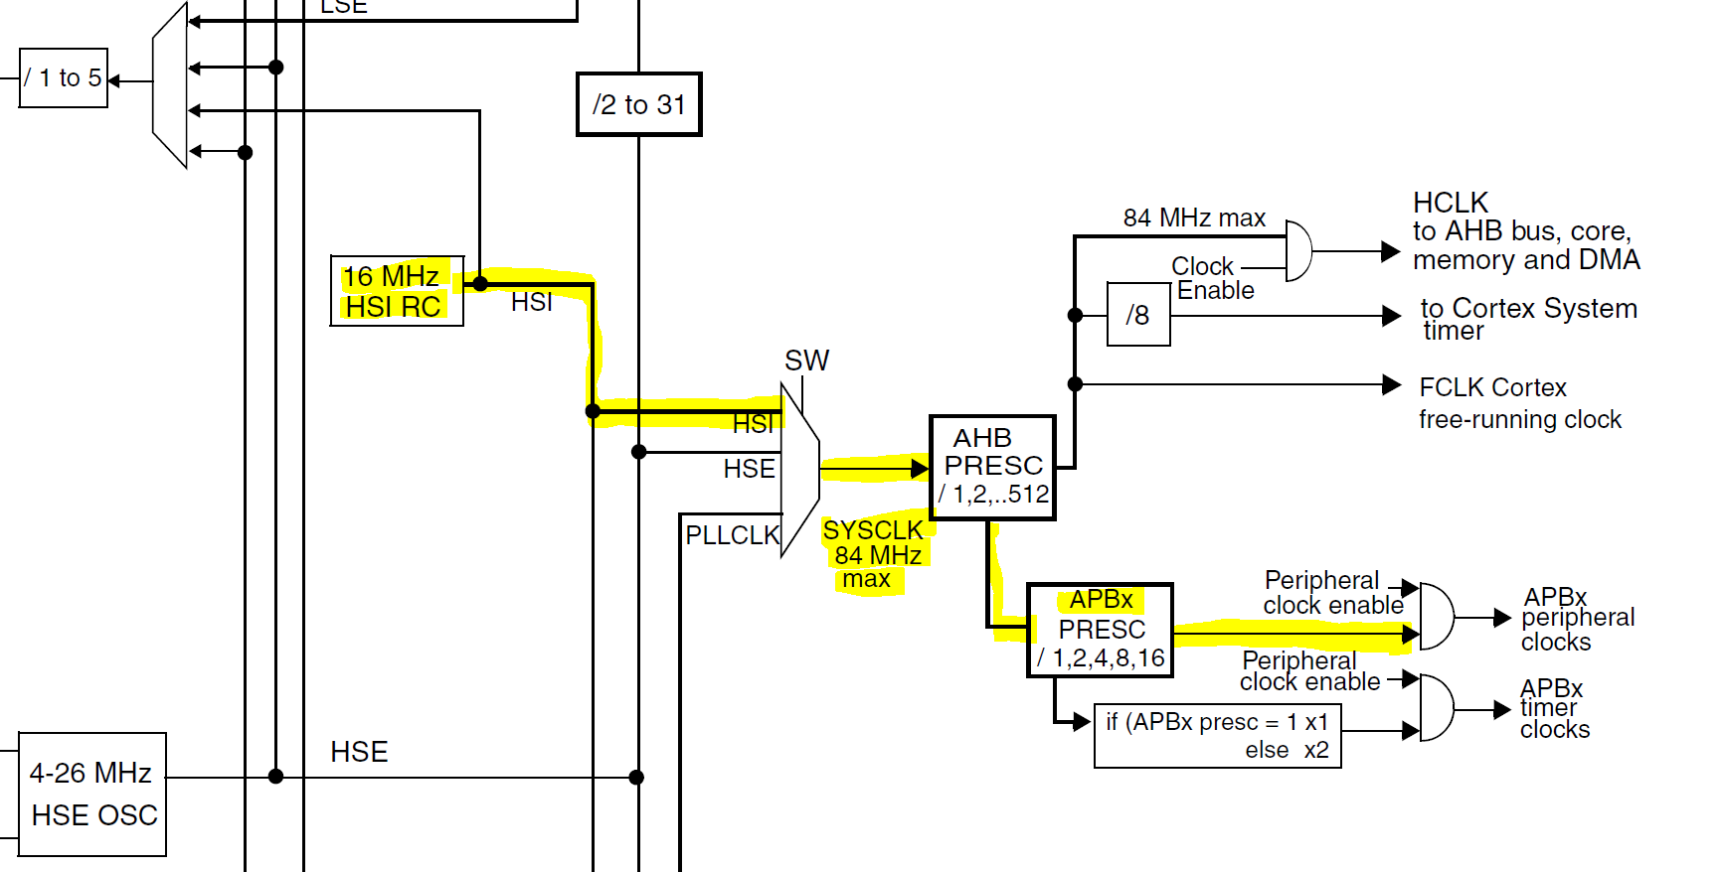
Default system clock rate
Default clock is 16 MHz High Speed Internal clock
It drives SYSCLK at 16 MHz
This limits the APBx rate which limits SPI bus rate
Which limits MP3 streaming rate

Slide 9
Increasing the system clock rate
Clock sources for SYSCLK, choose one of:
HSI high speed internal (16 MHz) default
HSE high speed external (4-26 MHz) – we don’t have external
PLL phase locked loop boosts HSI or HSE (depending on selection)
Our goal: increase clock speed for APBx to boost SPI throughput
Use PLL, but note the parameters that need tuning M, N, P, Q

Slide 10
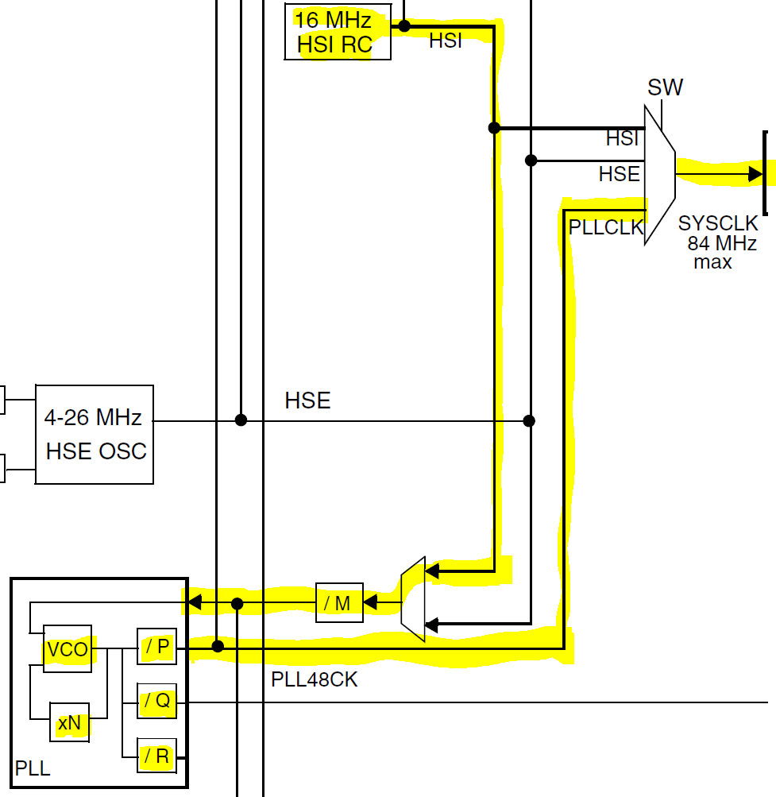
Change system clock rate
Note HSI is connected to PLL
Tune PLL parameters to boost PLLCLK rate
Change SW to take input for SYSCLK from PLLCLK

Slide 11
Increasing the system clock rate
Download files from canvas:
en.stsw-stm32091-1.zip
Unzip it to get STM32F4xx_Clock_Configuration_V1.1.0.xls
This is a tool for generating code to configure the system clock
Need Microsoft Excel to run it
Need to enable macros to allow it to run (instructions for disabling macros are displayed when you load the xls file)
This tool generates C code to configure the system clock
Begin by entering your desired HCLK frequency and clicking “Run”

Slide 12
Increasing the system clock rate
Good News!
You don’t have to tune the PLL parameters and generate the code!
Go to file startup.s
Uncomment these lines:
// LDR R0, =SystemInit
// BLX R0
Rebuild

Slide 13
Adding a command shell to your project
Need to launch a task using PJShellEntry() found in shell.c in the project

Slide 14
Findings of an embedded survey
Browsing the findings in a 2015 survey
Comparing Developer Activities between IoT and Non-IoT Developers
From EmbeddedMarket Forecasters

Slide 15
Taking a look at SD card protocol
See the separate slide file “SD Card protocol.pptx”

